Slide 1


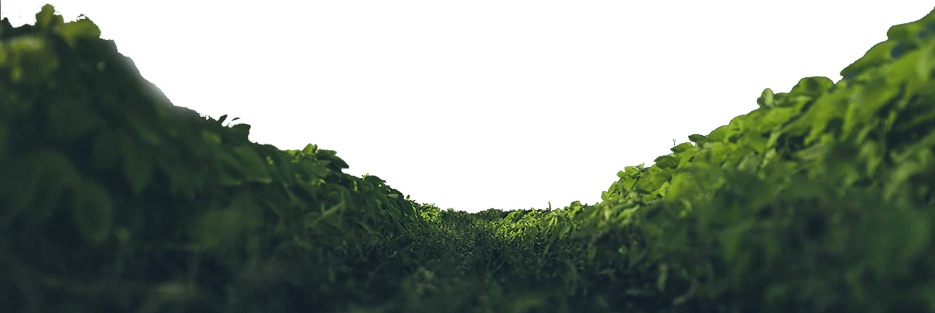
PERANCANGAN BAHASA KE ARAH PELESTARIAN BAHASA
BAHASA MELAYU NUSANTARA I (LM 1040)
SEKSYEN 2
Anisah Febi Yanmar - 1723988
Nisrina Iman Karima - 1727166
Kholilurachman Riefda Auliea - 1723992
Muhammad Fathudzikri Aulia - 1411773
Nisfiana Nola - 1722416

Slide 2

I. PENGENALAN
Definisi Pelestarian
perbuatan atau hal memelihara sesuatu supaya kekal seperti sediakala
Definisi Perancangan Bahasa
usaha untuk memupuk, memperbaiki dan mengembangkan suatu bahasa ke arah bahasa moden.

Slide 3
II. Kepentingan Pelestarian Bahasa
Peranan Bahasa Melayu
Sikap Pemusnah Bahasa Melayu
Sikap Menganggap Mudah
Sikap Lebih Menghargai Bahasa Asing
Akibat dari Sikap Pemusnah
Ketertarikan berlebih terhadap bahasa asing
Kurangnya keseriusan dalam penguasaan Bahasa Melayu dibandingkan bahasa asing

Slide 4
III. Kaedah Melestarikan Bahasa
Menegakkan Bahasa Melayu di Malaysia
Meningkatkan Kebangaan dalam Bahasa Melayu
Mainkan Peranan Aktif dalam membangunkan Bahasa Melayu
Keperluan undang-undang linguistik
E. Pegang Ujian Kemahiran Bahasa Melayu
F. Membuat Sekolah sebagai asas dalam memupuk Bahasa Melayu
G. Keperluan Pemahaman Masyarakat Terhadap Bahasa Melayu
H. Meningkatkan Disiplin dalam Bahasa Melayu untuk Semua Penduduk

Slide 5

IV. Perancangan Bahasa
Triceratops roamed the Earth during the latter half of the Cretaceous period, around 65-72 million years ago.
The Cretaceous ended with the most famous mass extinction in all of history; the Cretaceous-Tertiary.
Triceratops was one of the last dinosaurs to become extinct.
Mind blowing fact!
More time exists between Allosaurus in the Jurassic Period and Triceratops in the Cretaceous (83 million years) than between Triceratops and humans.

Slide 6
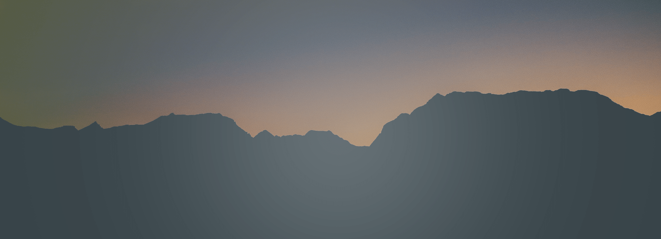




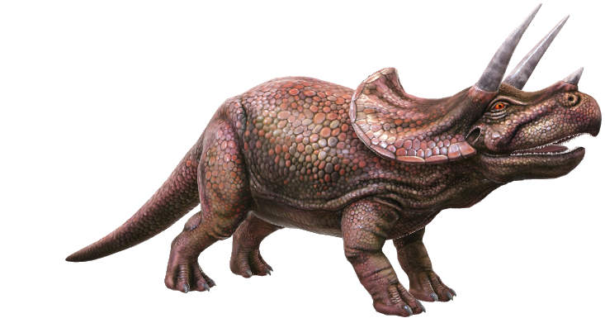
Where Triceratops Lived
Triceratops lived in parts of Western Canada and the U.S.
It liked marshy, forested areas– all the better to hide from its mortal enemy: the ferocious, T-Rex.

Slide 7
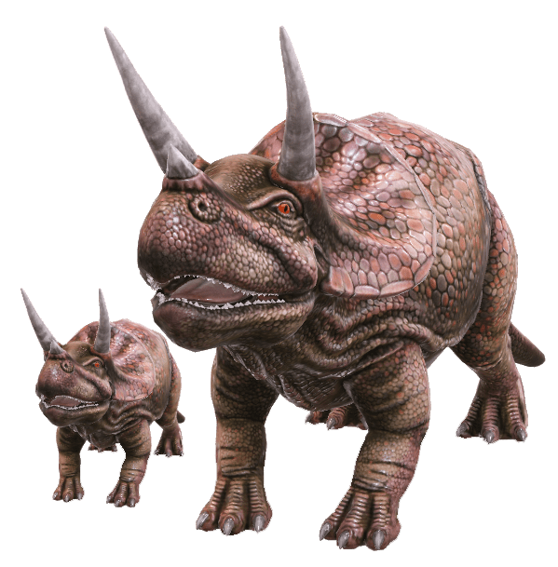
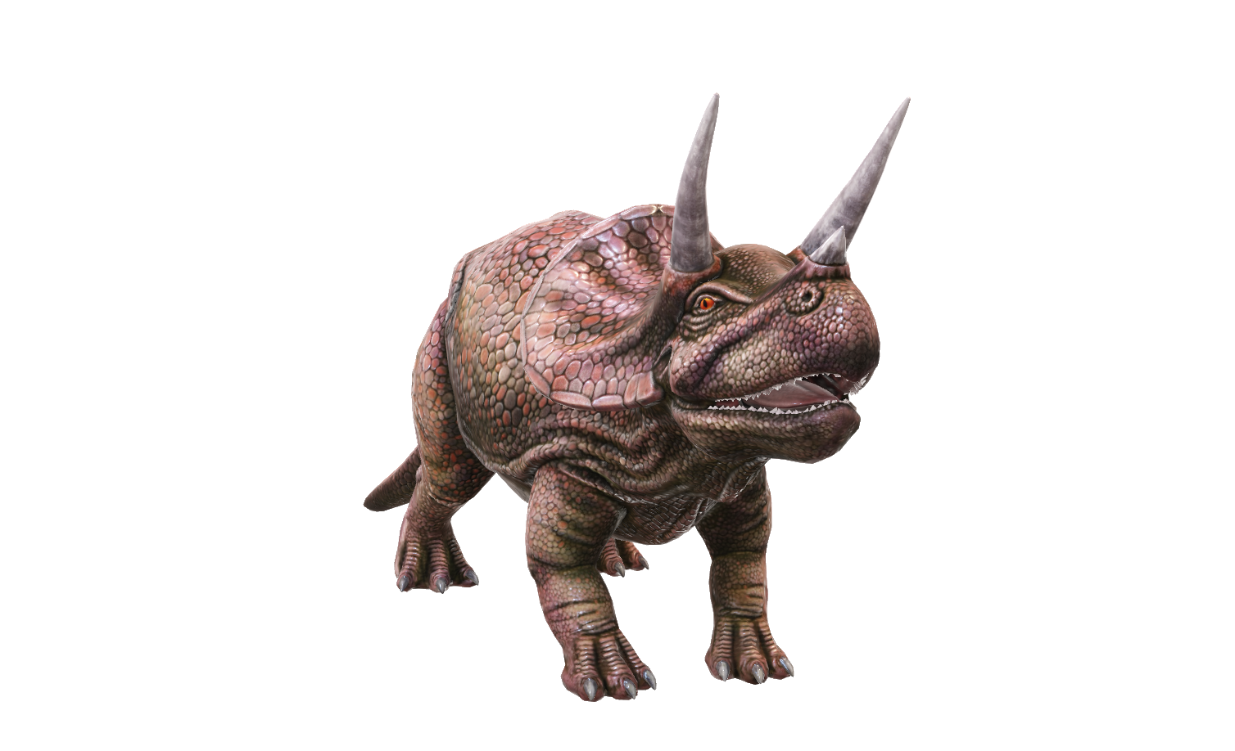
Triceratops Herds
Fossil Discoveries
The most recent fossilized discoveries suggest that Triceratops congregated and travelled in small groups, especially as juveniles, perhaps with their families.
There’s little evidence to show they lived in large herds.

Slide 8
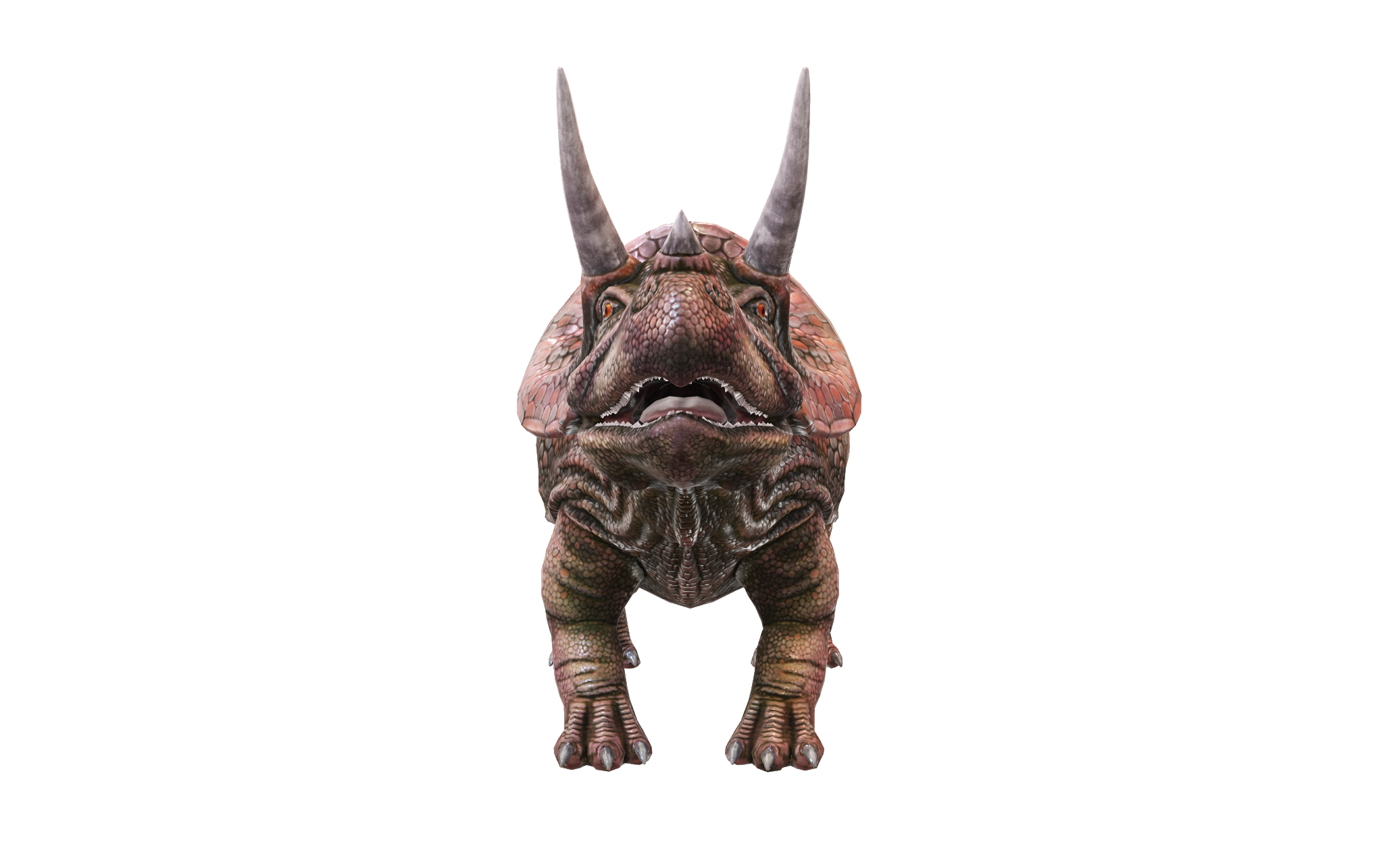
A Dentist's Nightmare
Triceratops Teeth
Triceratops teeth are one of the most complex of all animals that have ever lived.
Comprising 5 layers, and up to 40 ‘batteries’ (columns) on each side of the jaw, an adult could boast as many as 800 teeth!
These layers allowed Triceratops to munch through massive amounts of leaves, stems, and woody branches. When you weigh as much as 2 male elephants, you need a lot of food! But thankfully, they were herbivores…
The wear and tear of all this chewing was tremendous, hence so many teeth to replace ones that got damaged over time.

